Slide 1

USA: fra supermakt til avmakt ?

Slide 2
American exceptionalism
Change and/or decline?

Slide 3
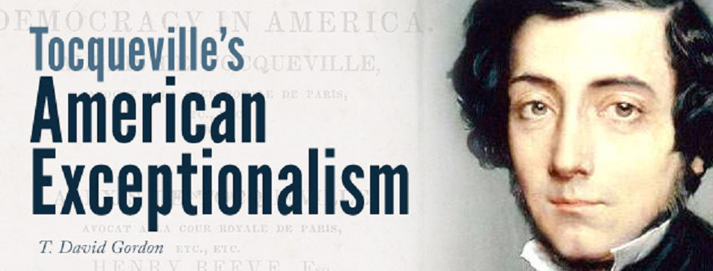
«Everything about the Americans, from their social condition to their laws, is extraordinary,
but the most extraordinary thing of all is the land that supports them»
Alexis de Tocqueville: Democracy in America, 1848 (1969), p. 280

Slide 4
The fallacy of ‘presentism’
The rosepainted past

Slide 5
 | Country A | Country B
T1 | Za | Zb
T2 | Zc | Zd
Absolute decline: Za > Zc
Relative decline: Zc > Za, but Zd > Zc

Slide 6
Table 1. Religious indicators in Europe and United States. 1999. Percent
Religion very/rather Attend once Positive towards religious
important a month people in public office
USA 83 60 49
Southern Europe 63 36 27
Northern Europe 47 27 28
Source:Peter B. Andersen, Peter Gundelach and Peter Lüchau
RELIGION IN EUROPE AND THE UNITED STATES. (2008)

Slide 7
Table 2 Prison population (pr. 100.000) Homicide rate (pr. 100.000)
USA 698 3.9
Canada 106 1.4
Source: UNDP (2017)Human Development Report 2016, p. 242

Slide 8
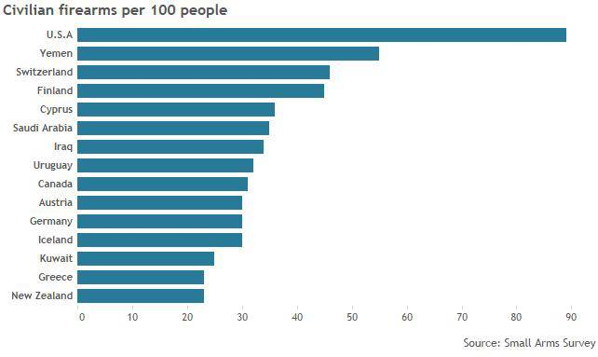

Slide 9
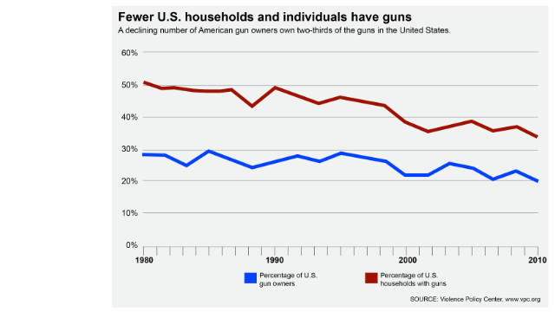

Slide 10
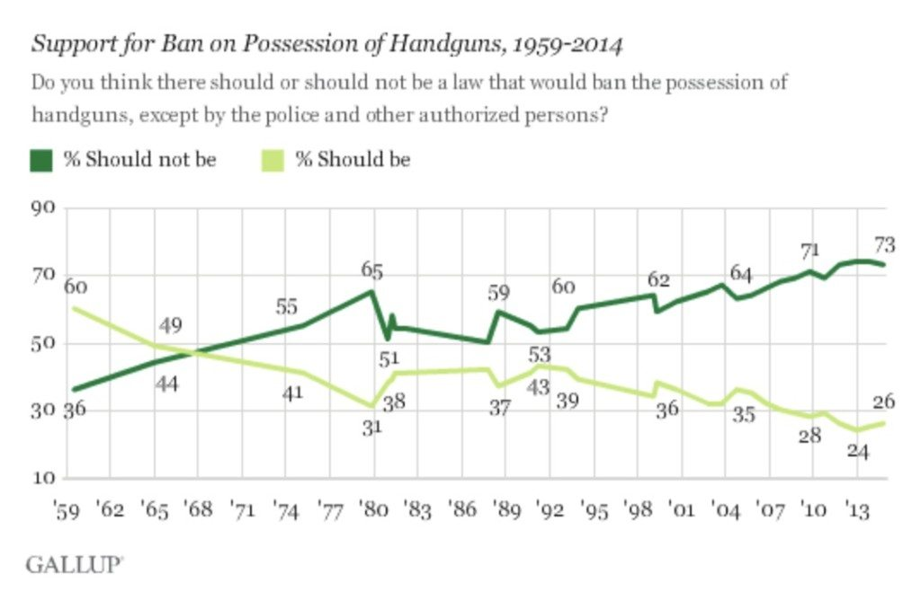

Slide 11
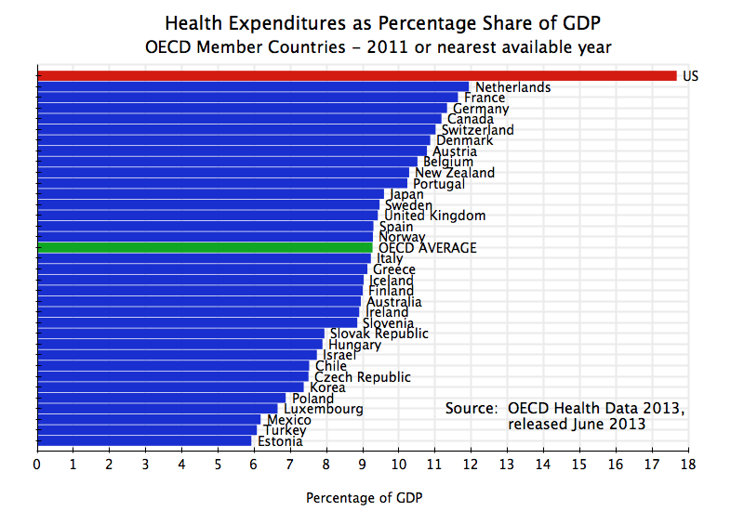

Slide 12
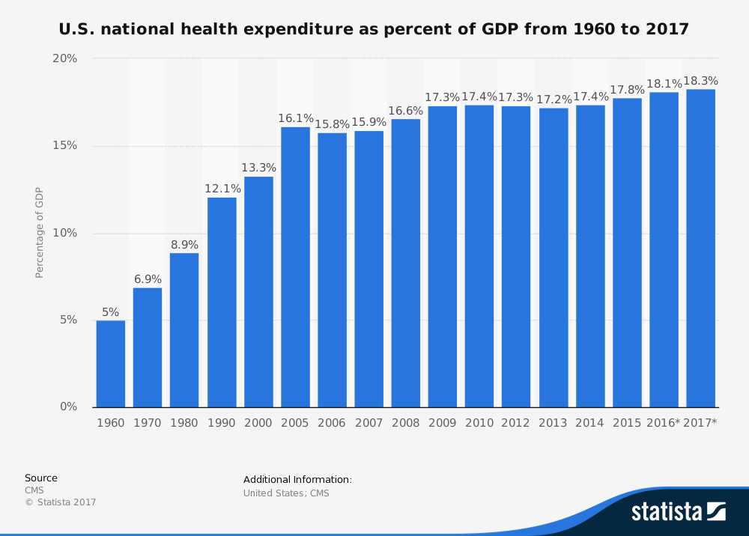

Slide 13
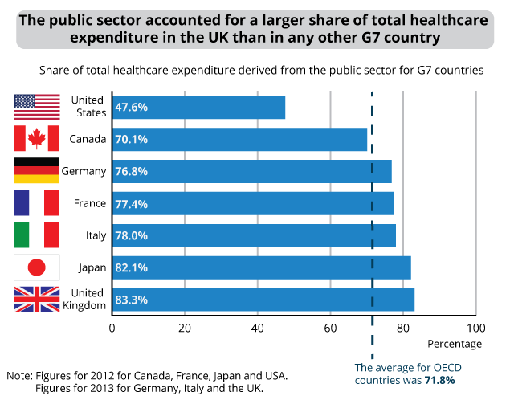

Slide 14
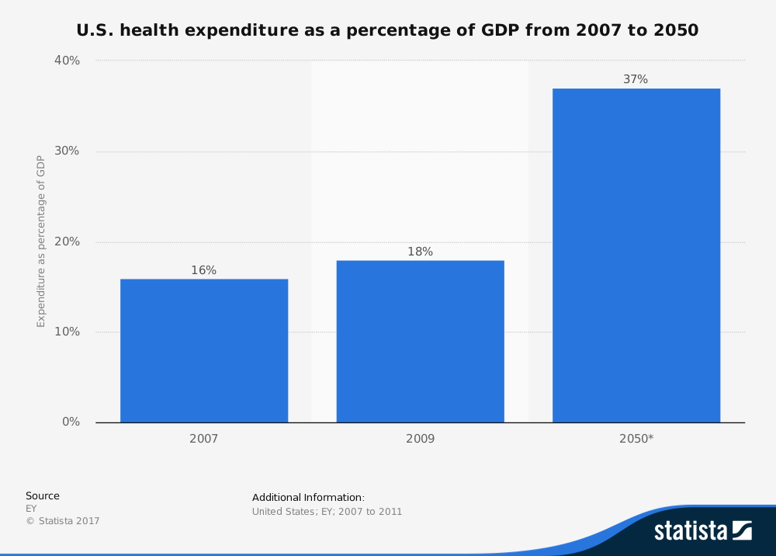

Slide 15


Slide 16
Norway US
It is the responsibility of the 60.0 38.3
government to reduce the
differences between people with
high incomes and those with low
incomes
The government should 78.3 47.1
provide a job for everyone
who wants one
The government should 78.4 34.2
provide everyone with a
guaranteed basic income
Source. Stefan Svallfors (1997) Worlds of Welfare and Attitudes to Redistribution: A Comparison of Eight Western Nations, European Sociological Review, Volume 13, Issue 3, 1 December 1997

Slide 17
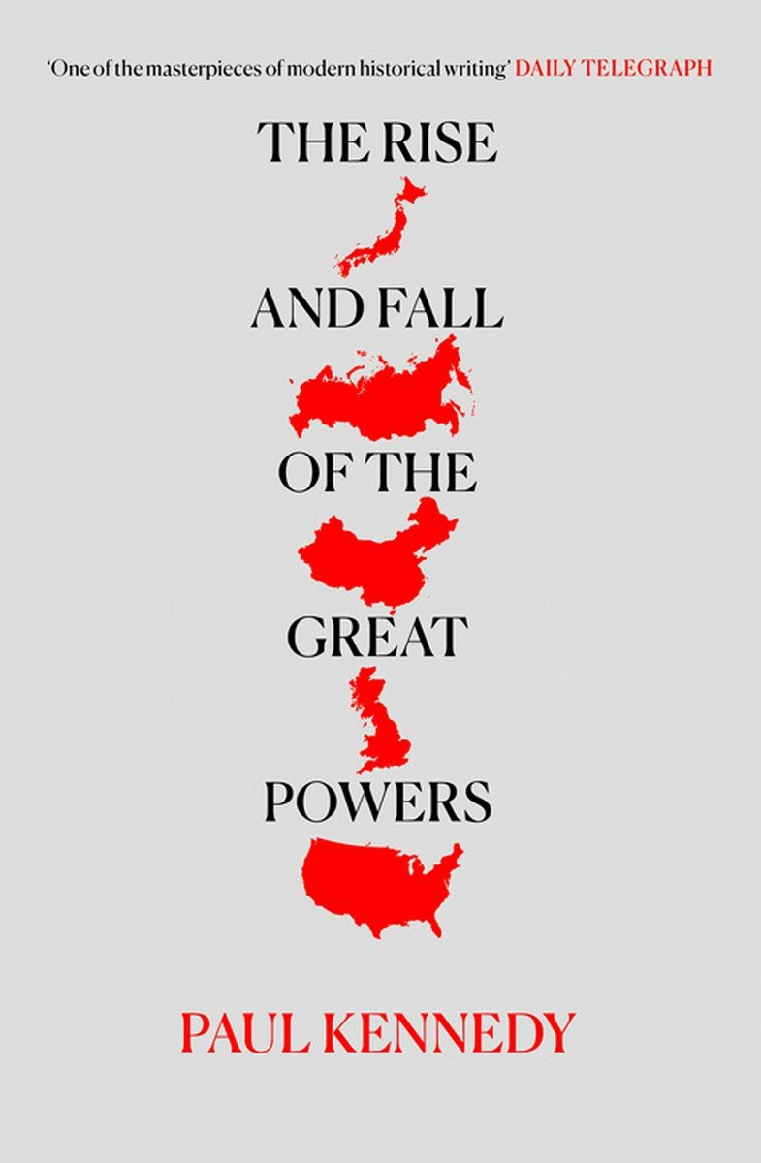

Slide 18

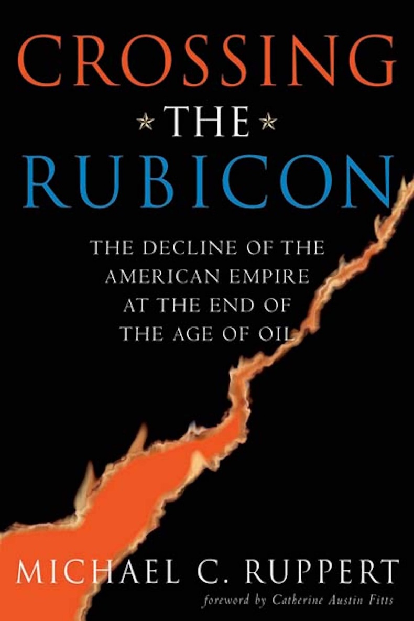


Slide 19
Sources of perceived decline:
Military set-back: Vietnam war
Domestic issues:
  Watergate
  Ethnic divisions
  Polarization
  Economic disparities

Slide 20
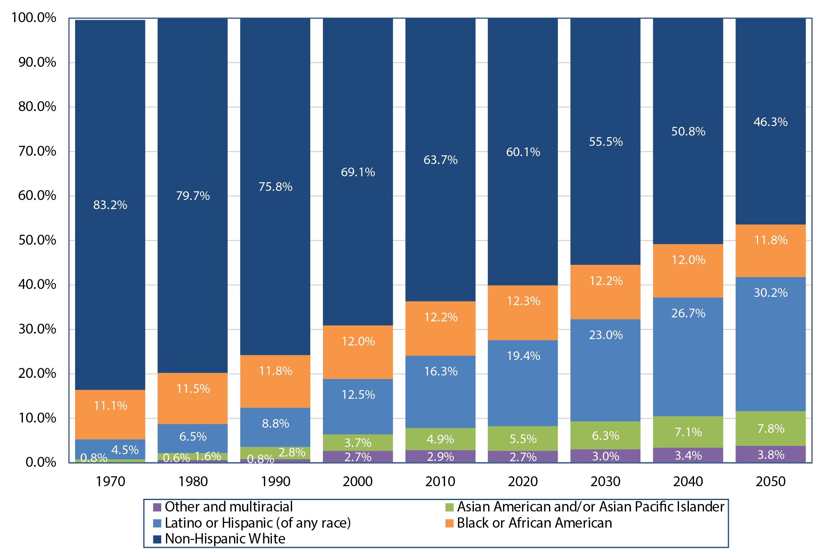

Slide 21
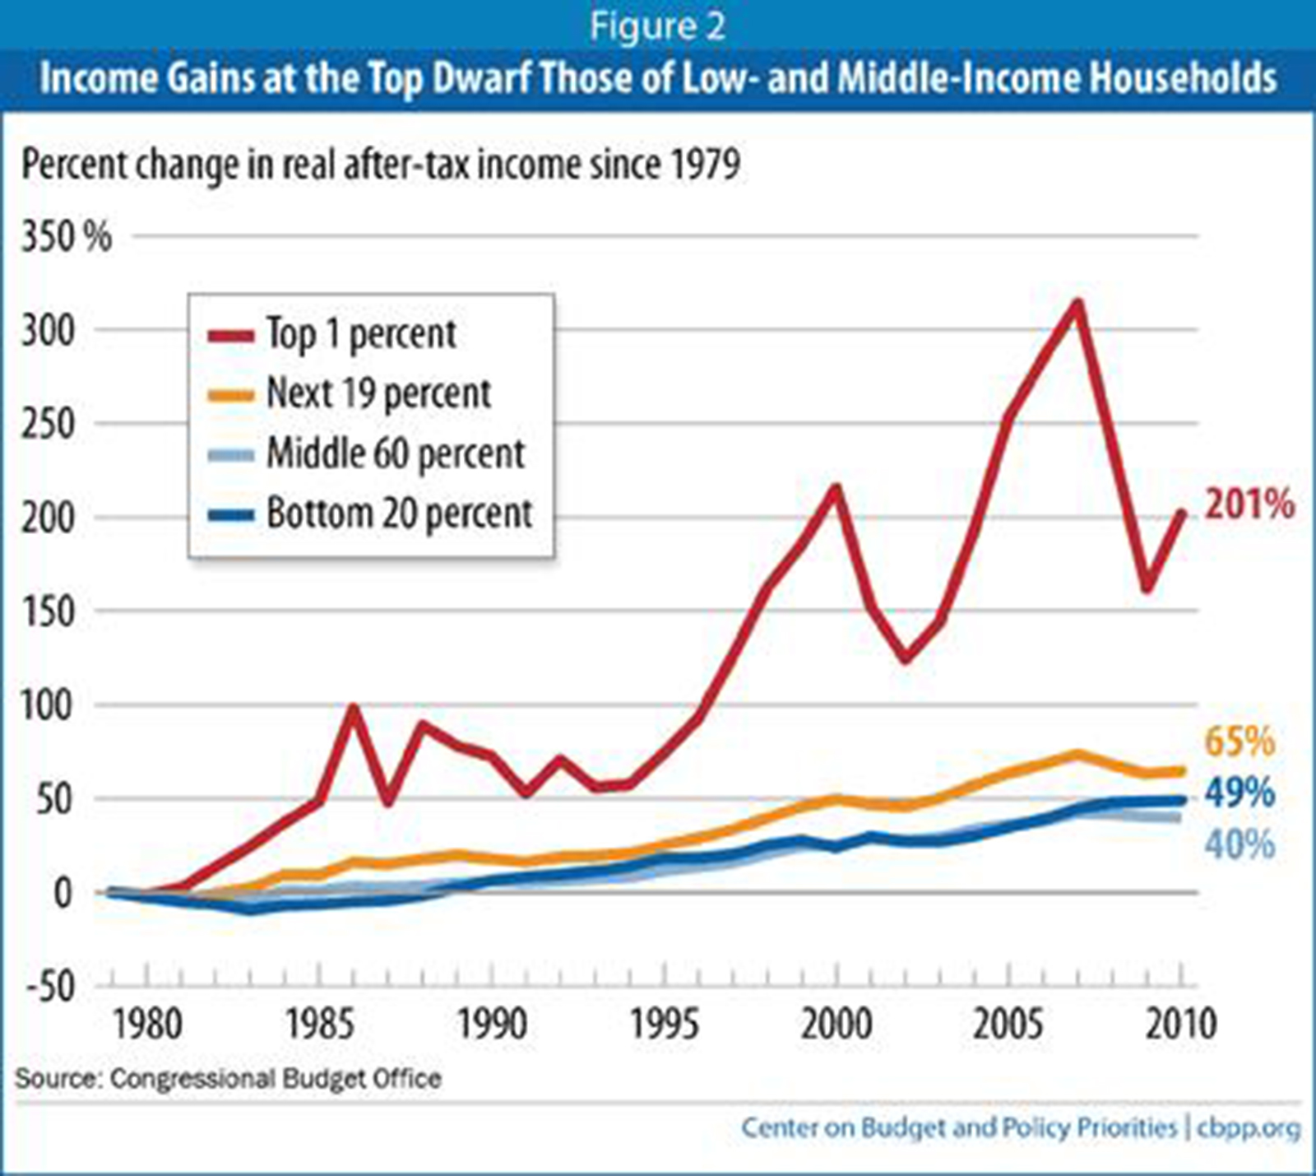

Slide 22
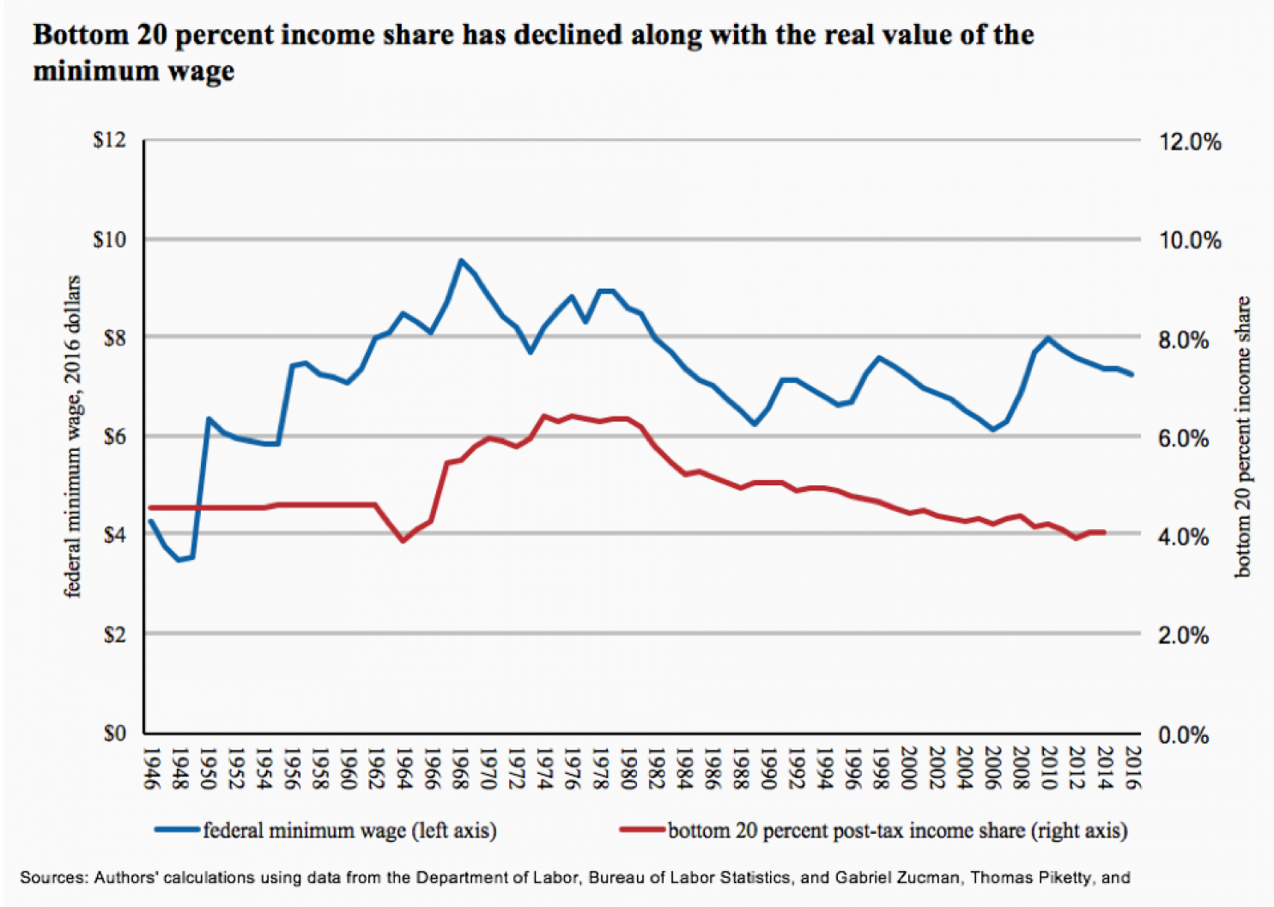
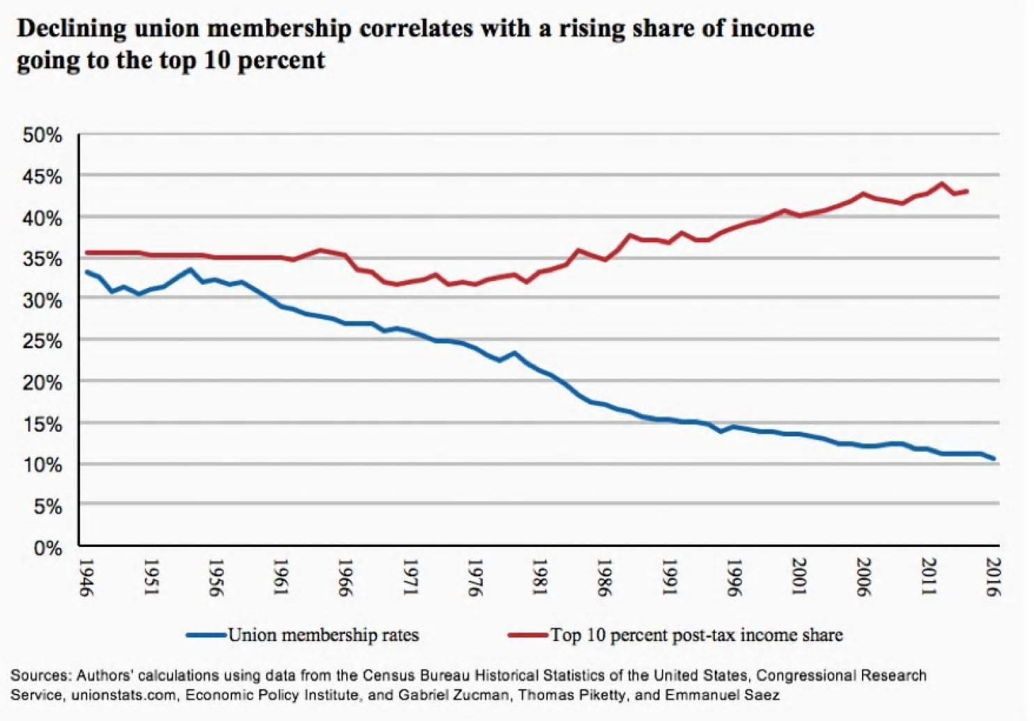

Slide 23
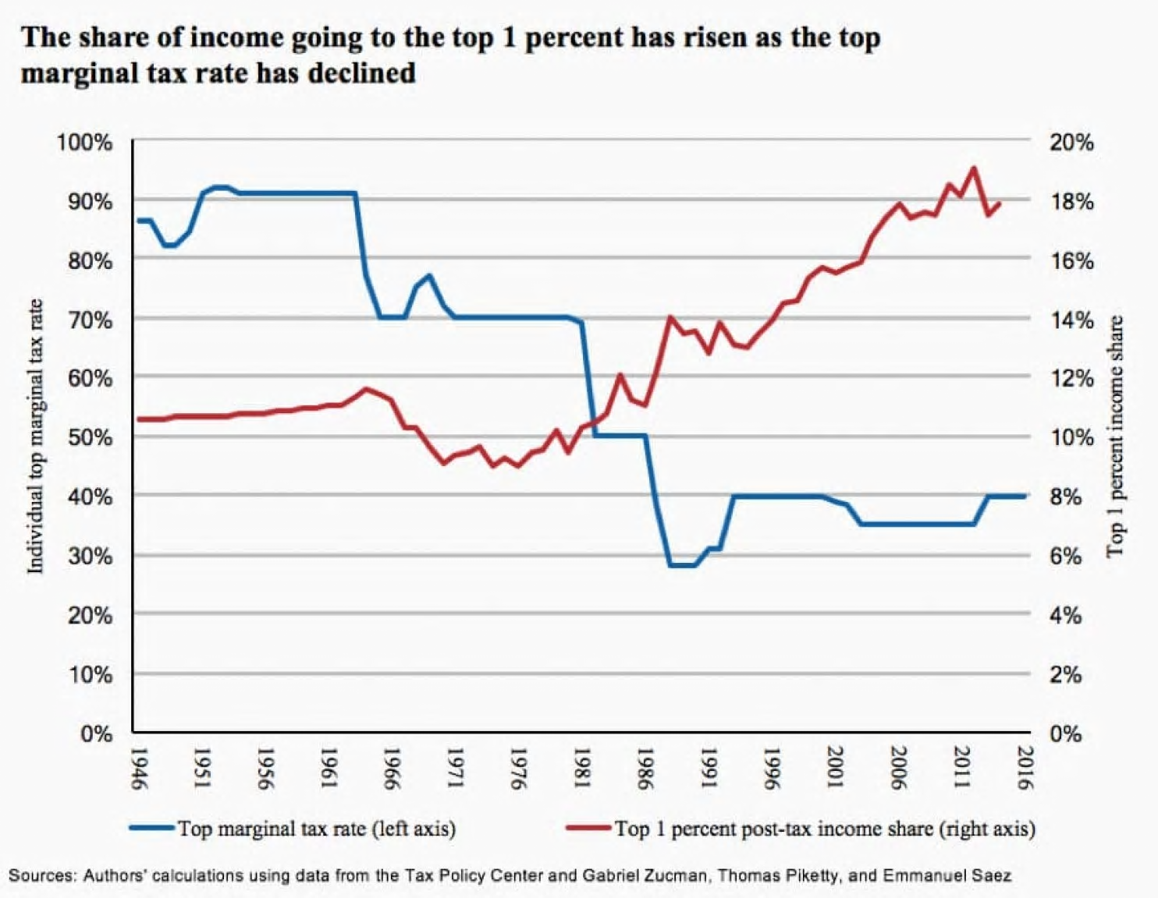

Slide 24
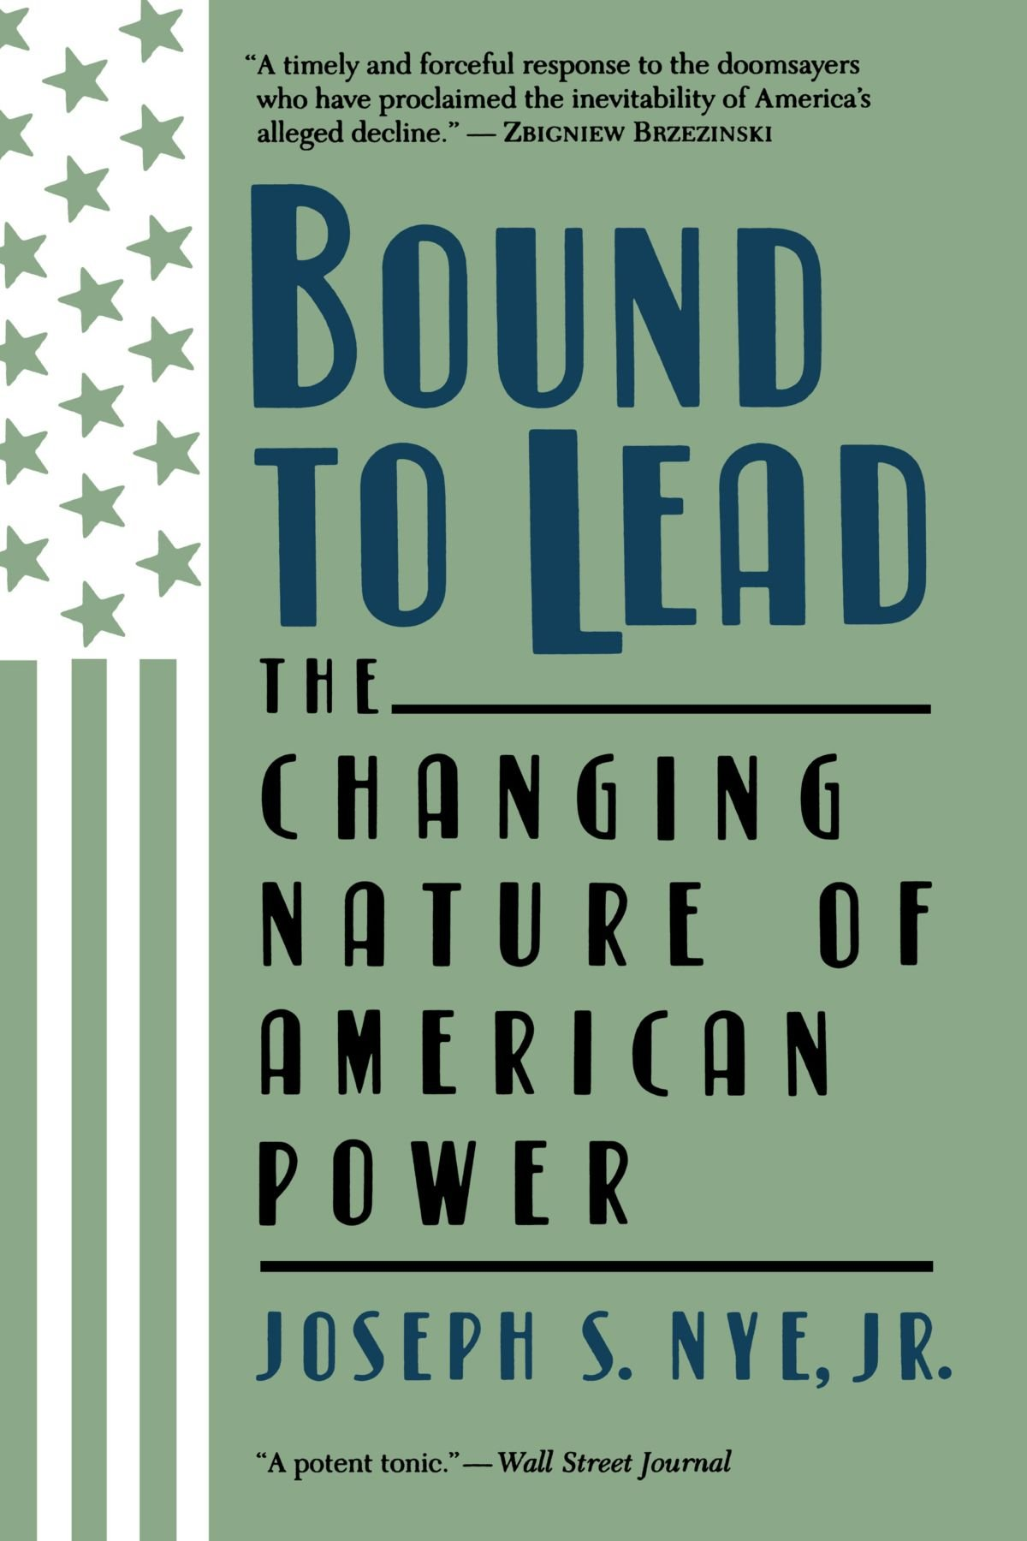

Slide 25
Multidimensionality of power:
Economic indicators
Military capacity
‘Soft power’

Slide 26
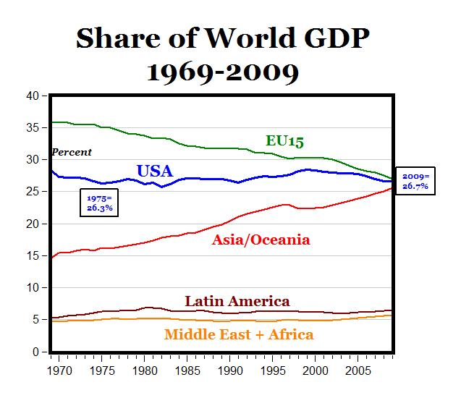

Slide 27
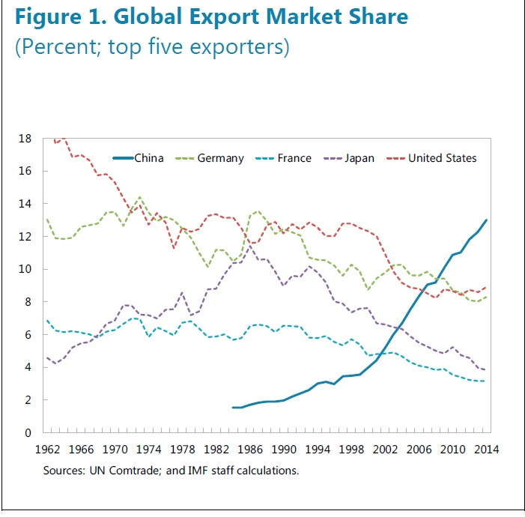

Slide 28
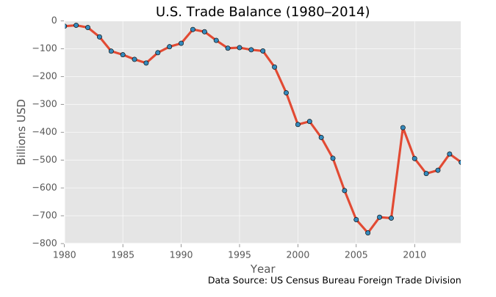

Slide 29
POTENTIAL BLACK SWANS THAT WOULD CAUSE THE GREATEST DISRUPTIVE IMPACT :
US Disengagement A collapse or sudden retreat of US power probably would result in an extended period of global anarchy; no leading power would be likely to replace the United States as guarantor of the international order.
Source:
GLOBAL TRENDS 2030: ALTERNATIVE WORLDS
a publication of the National Intelligence Council . 2012

Slide 30
Comparative defence statistics
National Intelligence report

Slide 31
